Slide 1


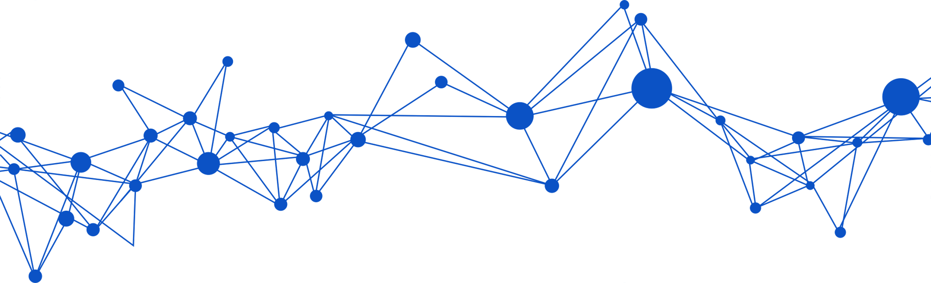
MULTI-AGENT
SYSTEM
ITALIAN PUBLIC ADMINISTRATION
Natural language-based data analysis and visualization
DESIGNED BY:
Paolina Beatrice Mazza
Carlotta Menasci
Alessandro Pausilli

Slide 2
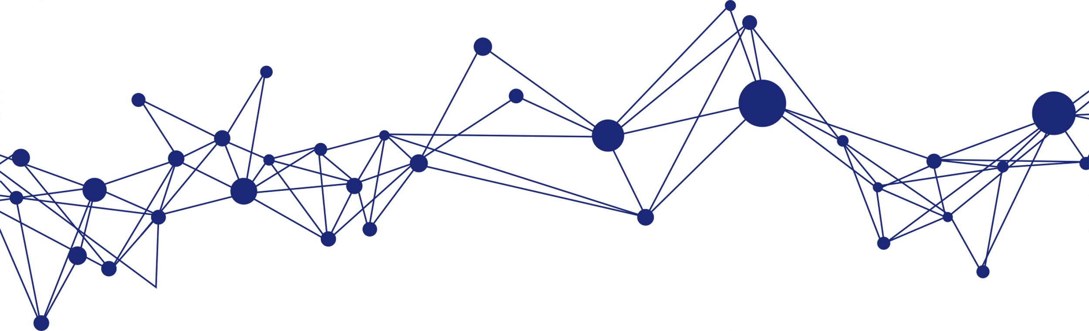
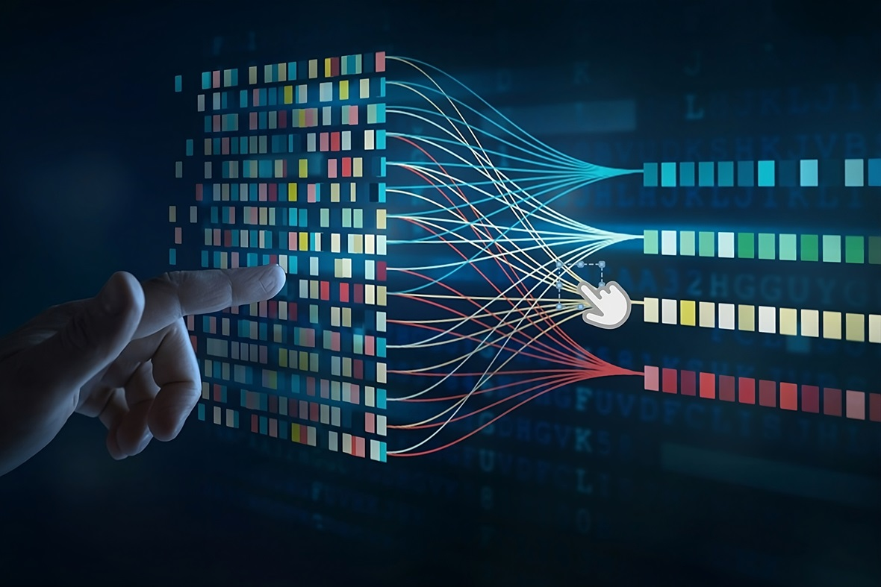
Overview of Datasets Used
EntryAccesso: Portal access by region, administration, age, gender, and login method.
EntryStipendi: Salary disbursements by administration, municipality, gender, age group, and payment method
EntryPendolarismo: Commuting distances, home/work municipality match, and routes by province
EntryReddito: Demographics of public employees by income brackets, gender, region, age, and sector
Shared fields across datasets (e.g., gender, age, administration) enable cross-analysis and merging

Slide 3
Two Architectures, One Choice
Explored Approaches
Local Agent (Mistral-Nemo)
OpenAI Agent SDK
• Offline, privacy-first
• Complex prompt engineering
• Metadata caching for dynamic queries
• Less powerful, slower, high hardware demands
Access to GPT-4
Out-of-the-box agent coordination
Scalability with minimal infrastructure overhead
Final Choice: OpenAI Agent SDK
→ More reliable, composable, and powerful despite initial uncertainty

Slide 4



How the OpenAI-Based System Works
3 Agents
ConversationAgent
Core Tools (via @function_tool)
InsightBuilder → Generates Python code
⚙️ CodeRunner → Executes it
ResultExplainer → Explains output
All actions are based on real datasets – no fake data, no hallucination
• Interprets queries
• Routes to sub-agents
•Tracks memory (token-aware)
DataProcessingAgent
• Data Analysis
• Returns insights + explanations
VisualizationAgent
• Builds plots via Matplotlib
• (Optionally) explains visual results

Slide 5

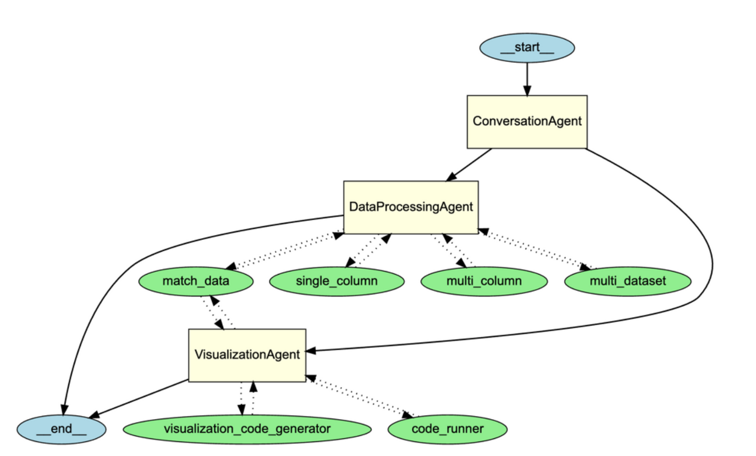
How We Got Here
From Hardcoded Tools to Prompt-Based Reasoning
Initial System (Hardcoded Toolchain)
DataProcessingAgent used 4 rigid tools:
• match_data (semantic matcher)
• single_column, multi_column,
multi_dataset
(manual rule-based analysis tools)
Strengths
explicit logic, structured flow
Drawbacks
• High maintenance & complexity
• Low flexibility to new queries
• Heavy & slow (especially match_data with embeddings)
• Difficult to chain operations

Slide 6

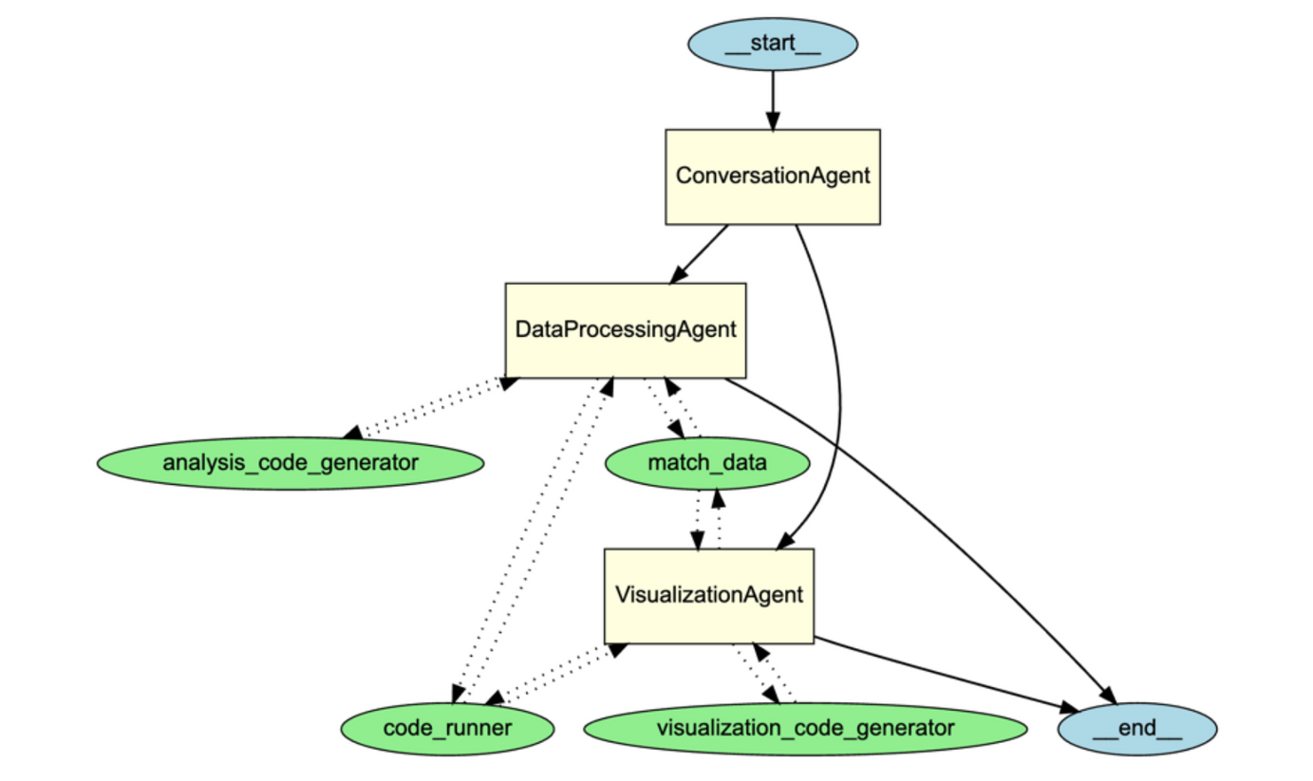
The Turning Point: Towards Prompt-Based Modularity
Intermediate System
Split into 2-step pipeline:
match_data: query parser + column matcher
InsightBuilder: code generator
Goal
More modular, still rule-based but clearer logic

Slide 7

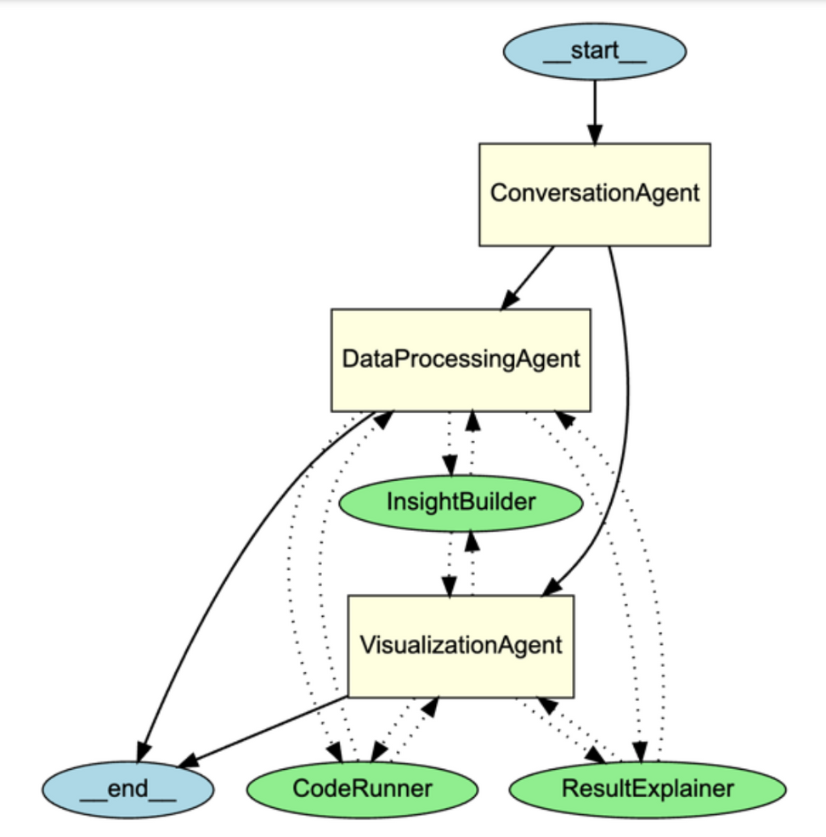
Final System: Simpler, Faster, More Powerful
Final Transition
match_data → completely removed
InsightBuilder becomes single smart prompt-based tool:
✔ Understands the query
✔ Identifies datasets & columns
✔ Generates full executable Python code
Benefits of Full Prompt-Based Reasoning
More flexible: handles any analysis pattern
Faster: reduced latency, no embeddings
Robust: works even with vague queries
Clean: fewer tools, easier to maintain
Tried merging agents → Worse performance

Slide 8
Evaluation Methodology
Assess the accuracy and robustness of the multi-agent system compared to manual Python solutions.
GOAL
23 user queries from Evaluation_Questions.csv
Agent Answer vs Manual Ground Truth
Each test included:
• Natural-language prompt
• Expected Python code + output
• Agent output
• Correctness label: YES / NO
EVALUATION SETUP
METRIC USED
Accuracy = % of correct answers
Result: 96% (22/23 queries correct)

Slide 9
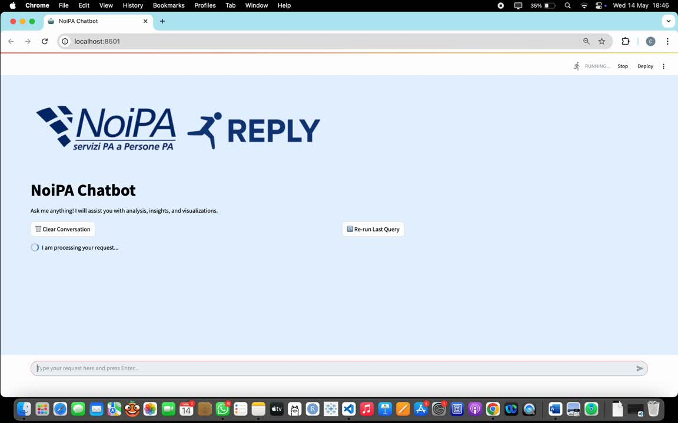
Let’s see it in action!

Slide 10
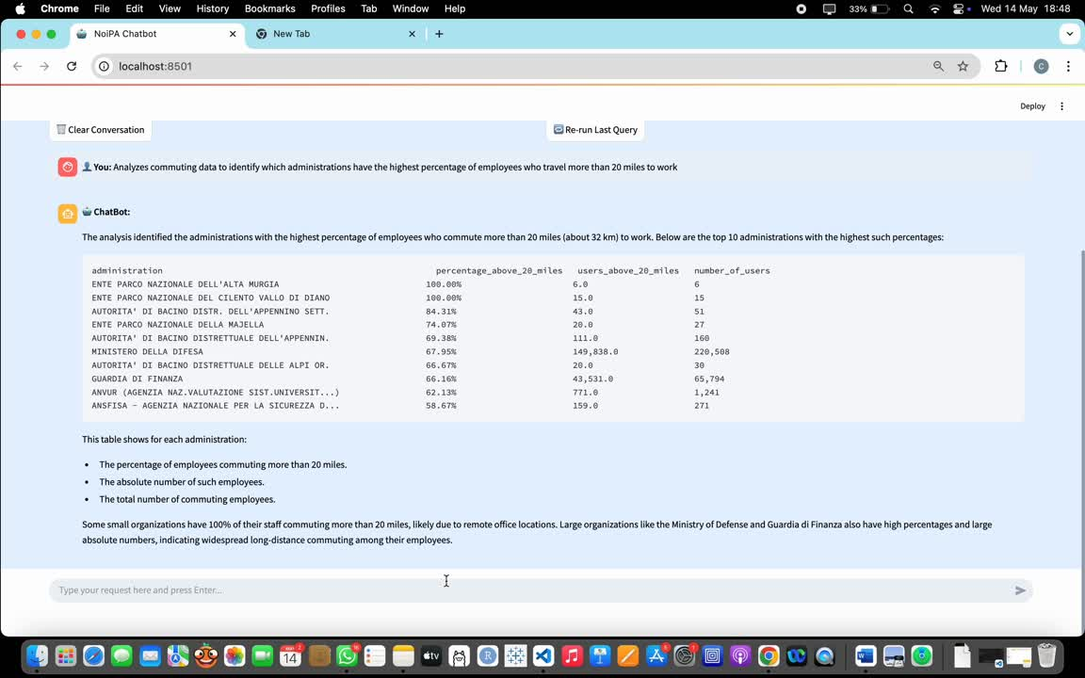
Memory Test

Slide 11
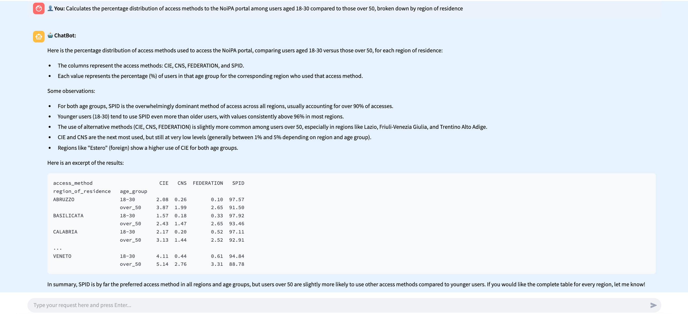
Other Tests...

Slide 12
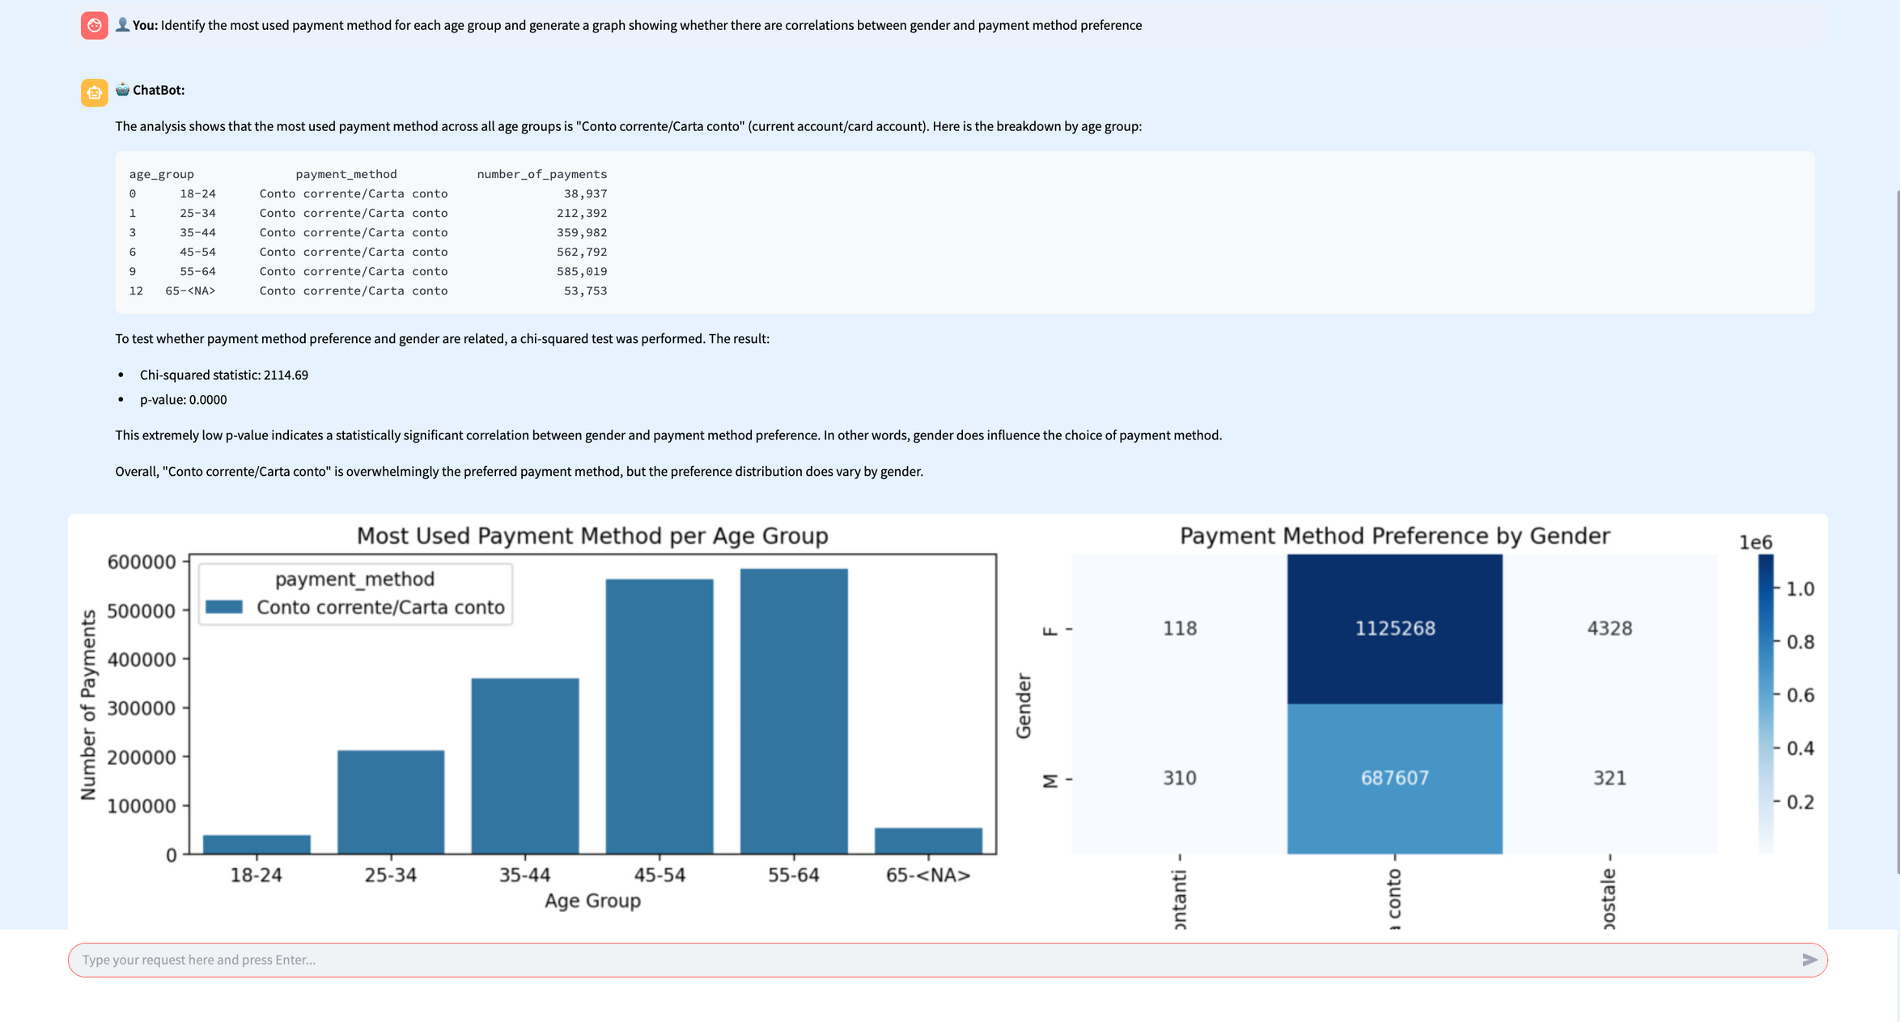
Other Tests...

Slide 13
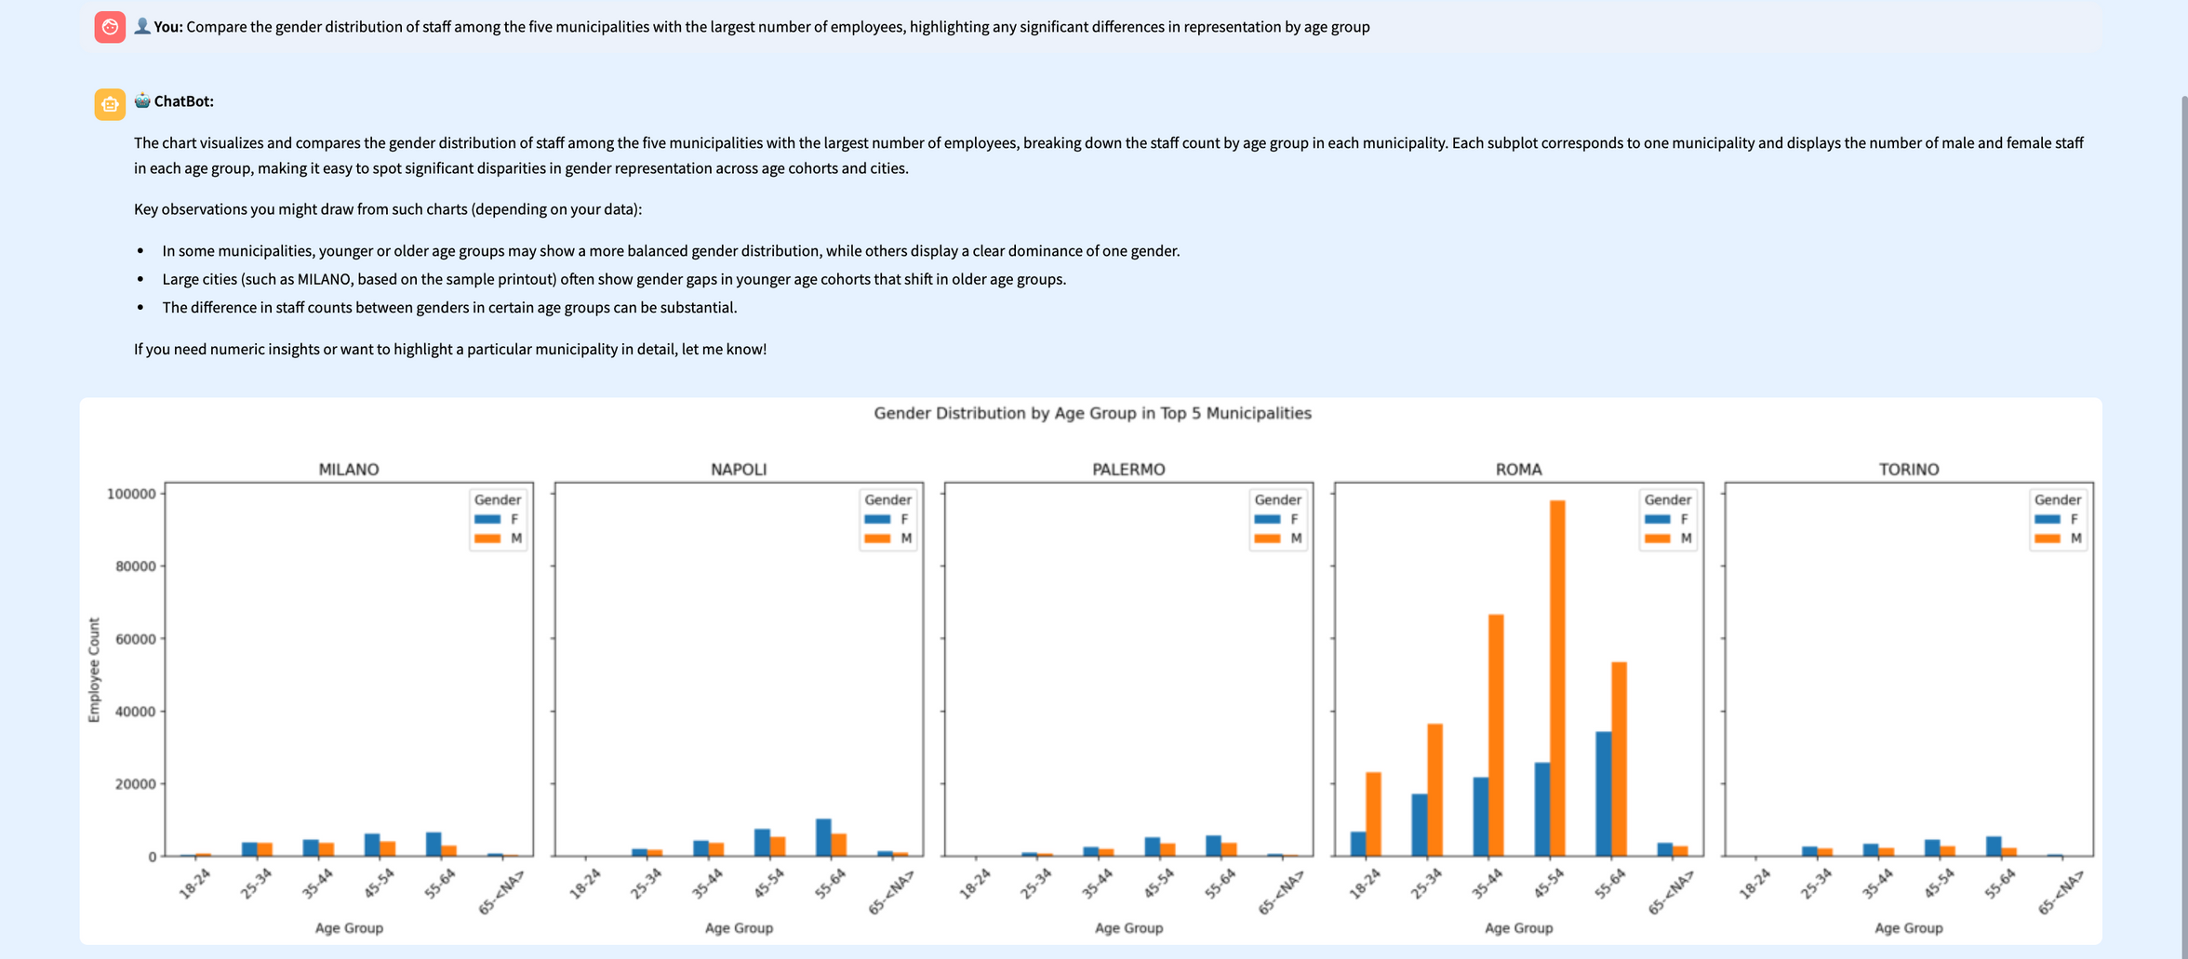
Other Tests...

Slide 14
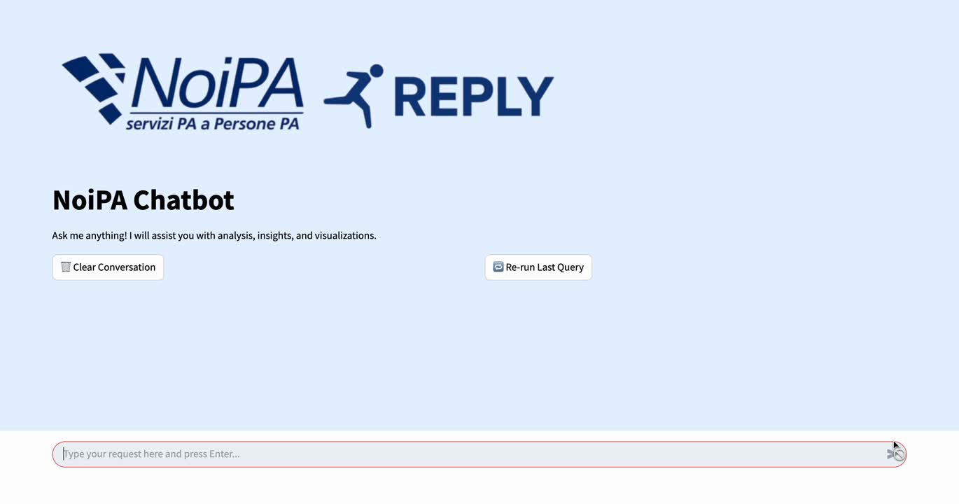
VisualizationAgent in Action

Slide 15
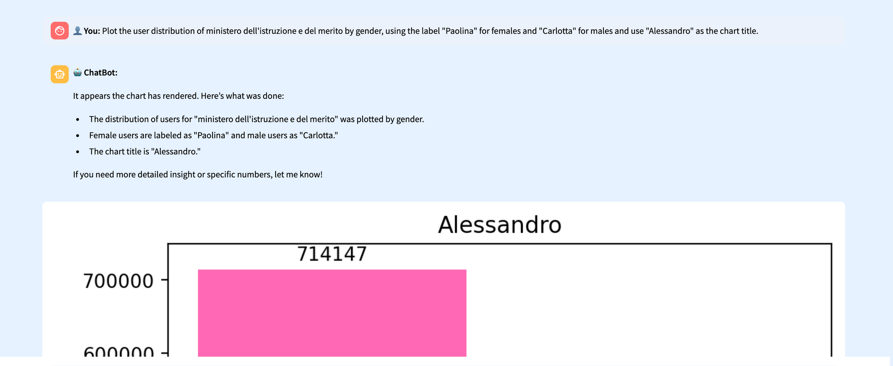
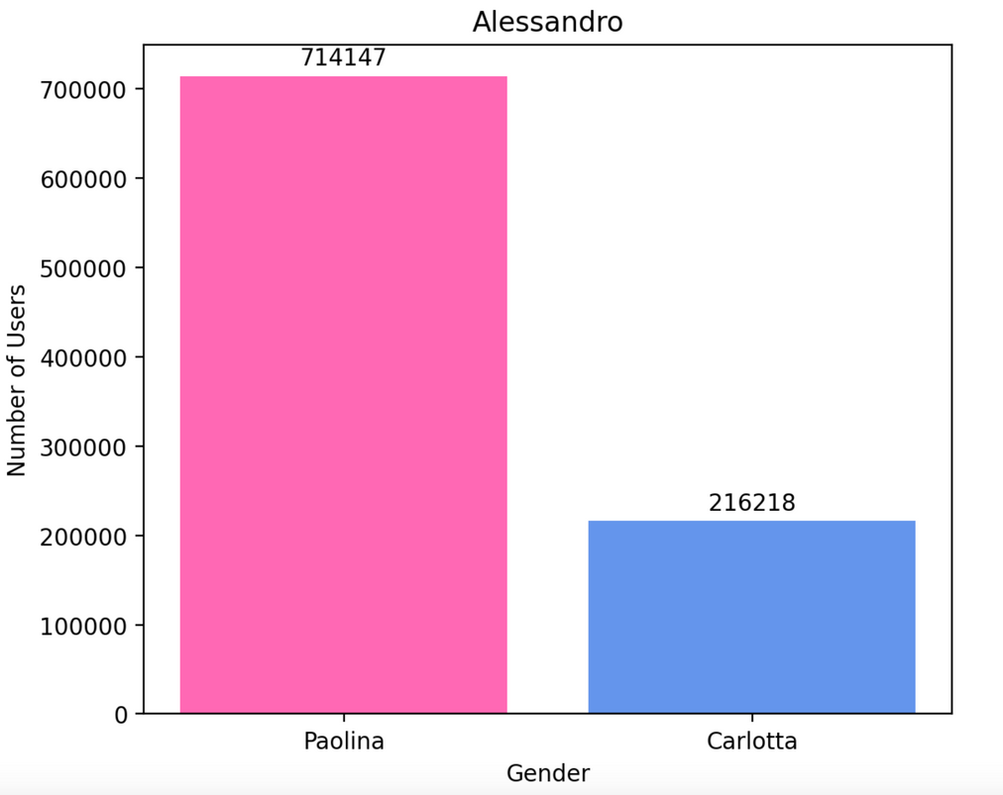
Obedient Agent Behavior

Slide 16
Conclusion
Project Outcome
✔ Designed and implemented a modular multi-agent system
✔ Natural language → Code → Visualizations & Insights
✔ Powered by OpenAI Agent SDK with memory & shared tools
✔ Accessible even to non-technical users
Impact
Makes structured public data explorable via conversation
Ensures reproducibility, auditability, and user-friendliness
Limitations
Ambiguous or multi-dataset queries can still be fragile
Evaluation limited to fixed datasets

Slide 17


Thank You
For Your Attention
If you have any questions, feel free to reach out !
carlotta.menasci@studenti.luiss.it
p.mazza@studenti.luiss.it
alessandro.pausilli@studenti.luiss.it

